Slide 1

WEYLAND ENERGY
Building Harrow Bay: lessons from year one
North Sea Energy Summit 2026 · Hamburg · Elena Márquez

Slide 2
Harrow Bay in numbers
480
1.9
520,000
2028
MW – 40 × 12 MW turbines
TWh per year
homes equivalent
commercial operation
WEYLAND ENERGY · Building Harrow Bay – lessons from year one
2

Slide 3
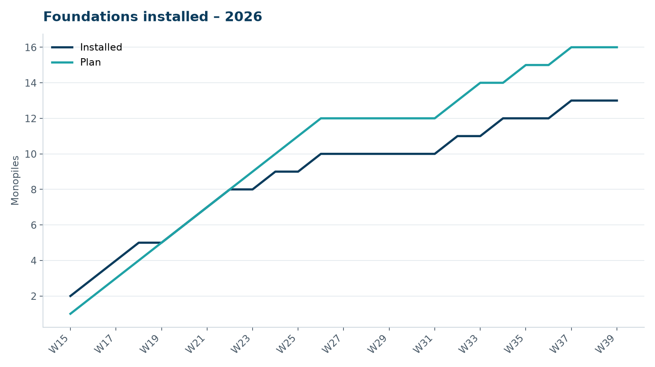
Where we are
• Construction start 7 April 2026
• Offshore substation topside installed 19 August
• Foundations: weather, weather, weather
WEYLAND ENERGY · Building Harrow Bay – lessons from year one
3
Notes:
Don't go into the exact numbers vs. baseline – public audience. Say 'a stormy September'.

Slide 4
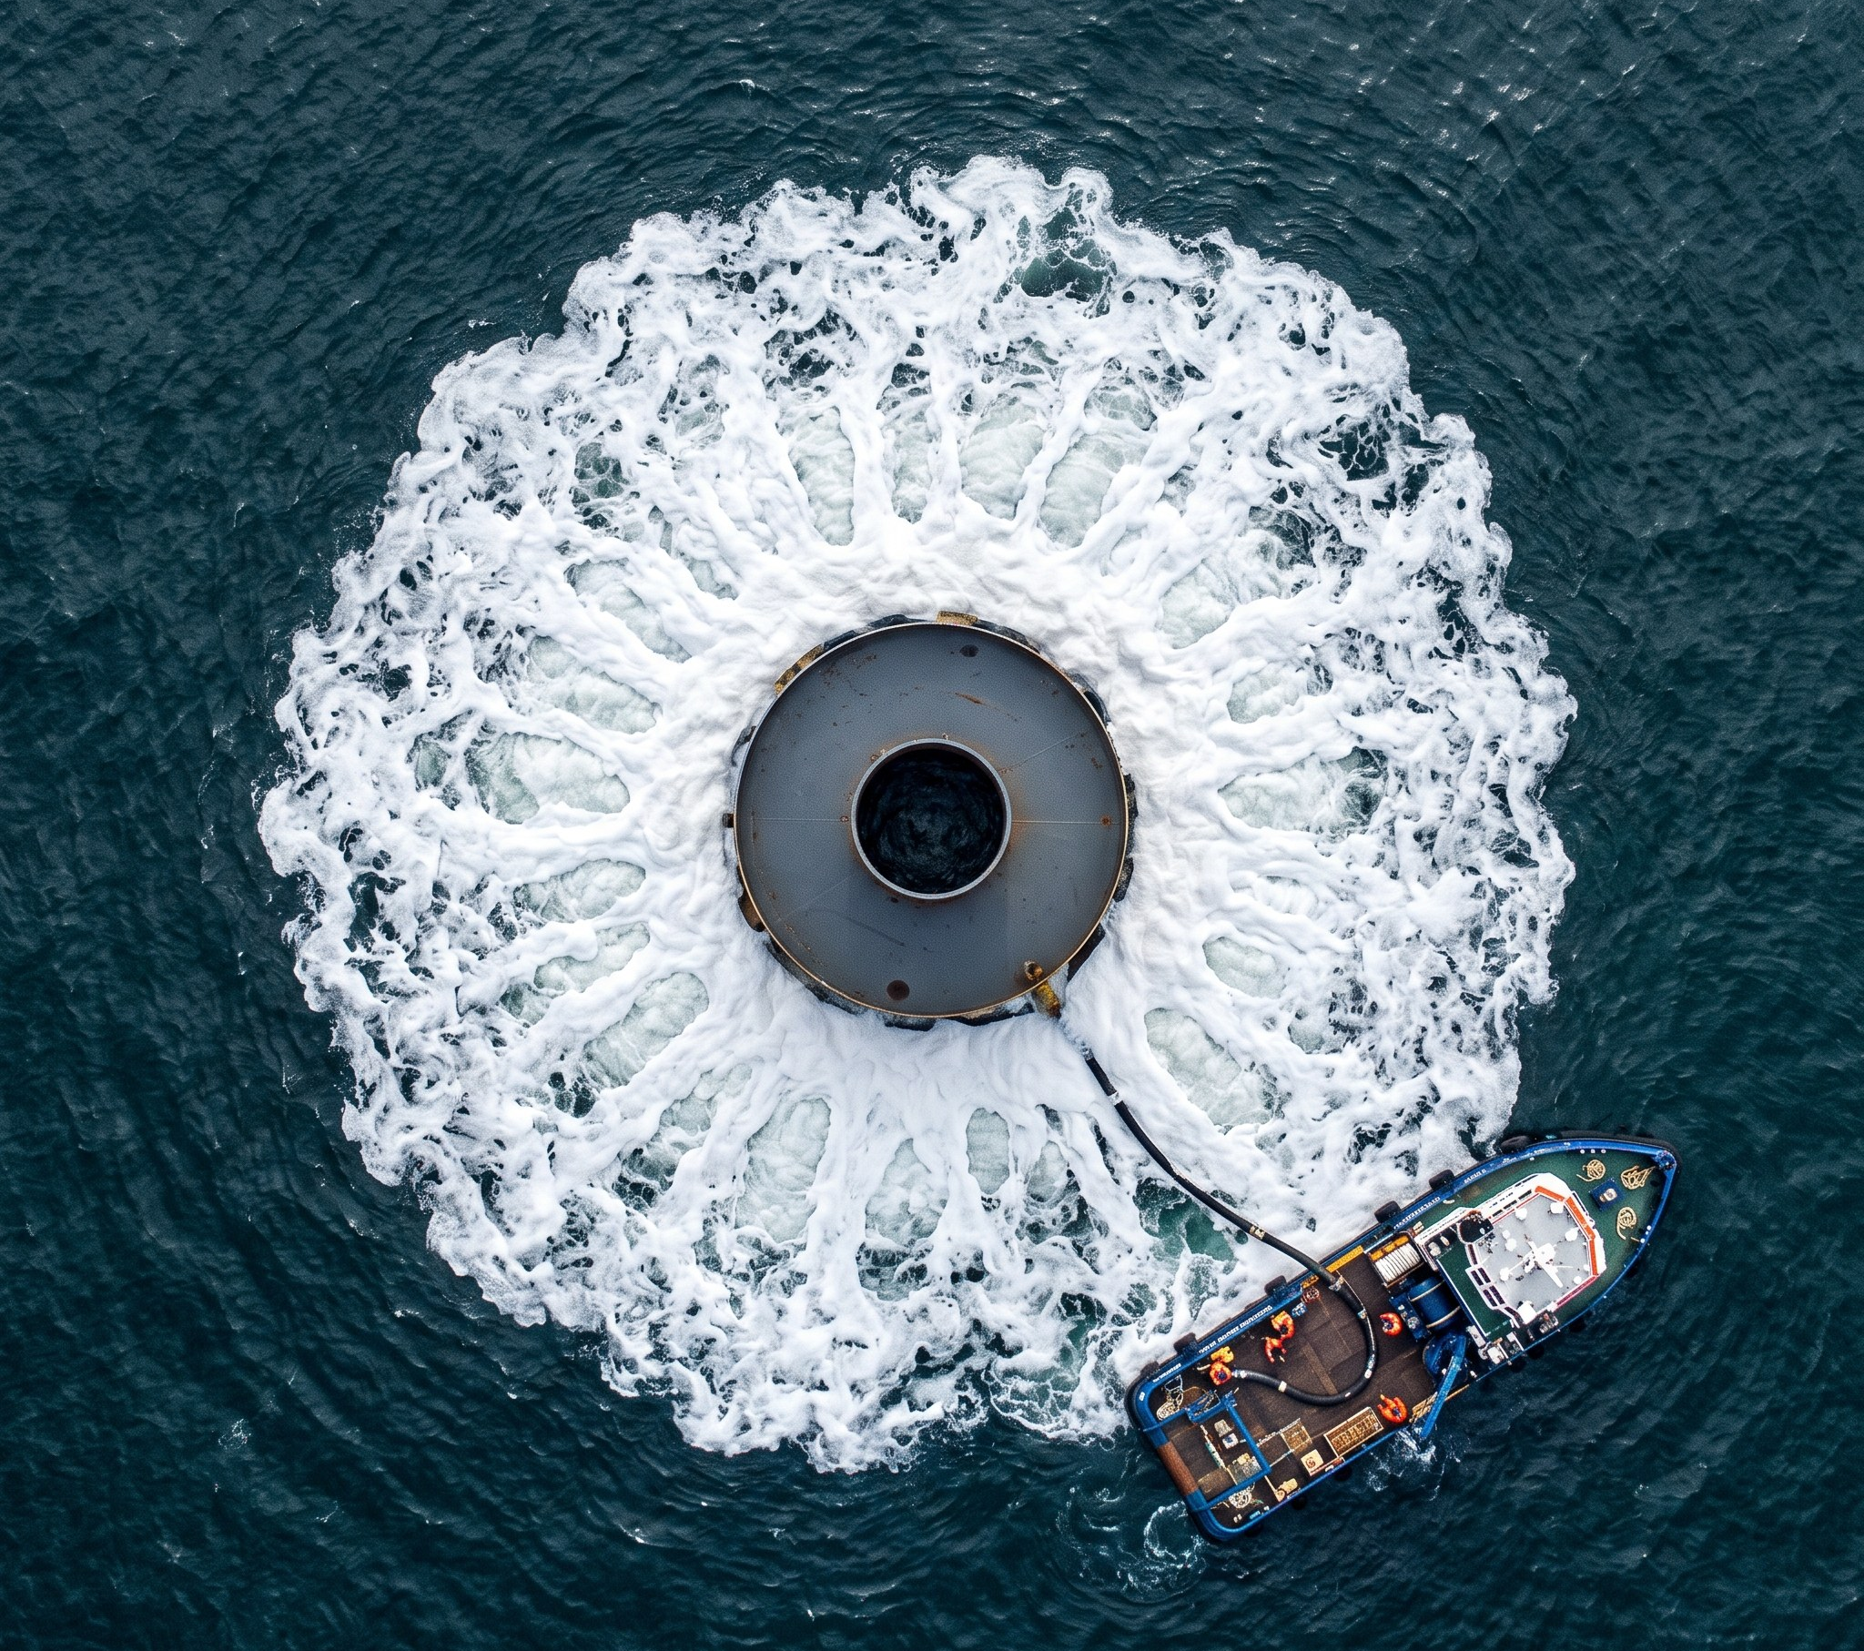
Lesson 1 – Noise is a design parameter
• Double bubble curtain on every pile
• One exceedance at pile 4 → hammer energy cap
• Marine mammal monitoring data shared openly with our ecologists
WEYLAND ENERGY · Building Harrow Bay – lessons from year one
4

Slide 5
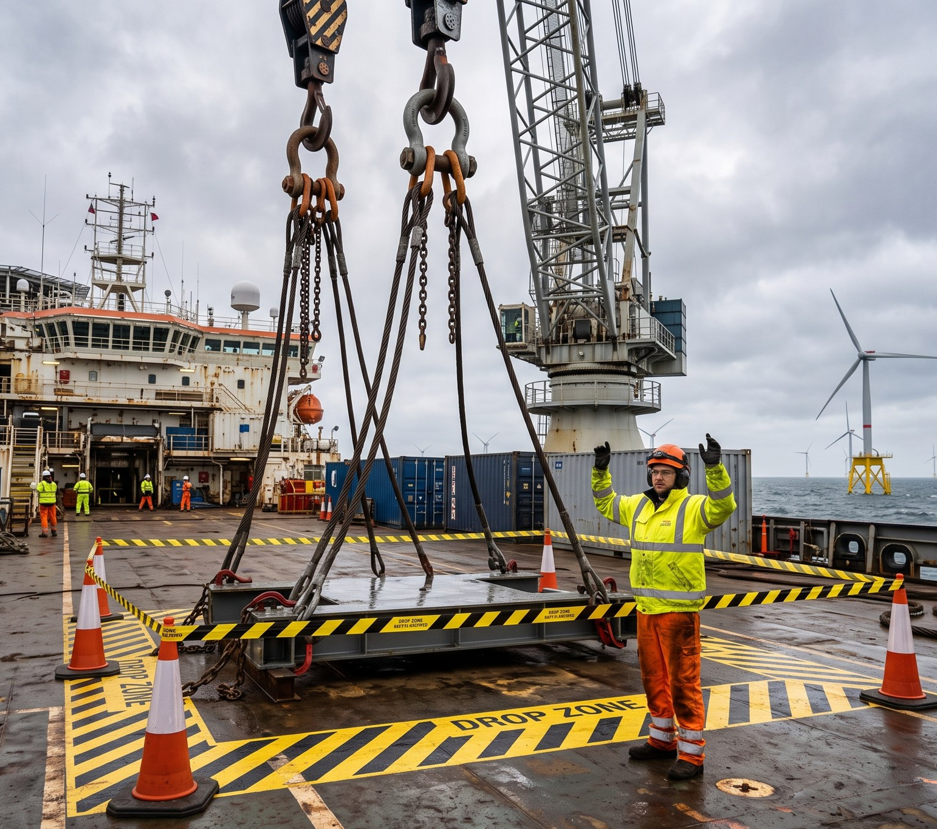
Lesson 2 – Small things kill
• A 2.8 kg shackle pin fell 18 m on our vessel in June
• Nobody hurt – because people stood outside the drop zone
• Now: secondary retention checked every single lift
WEYLAND ENERGY · Building Harrow Bay – lessons from year one
5
Notes:
Tell the story of the banksman. Keep it human. 2 minutes max.

Slide 6
Lesson 3 – Plan for the supply chain to fail
• A factory test failure can move a cable by 8 weeks
• Resequencing beats waiting
• Keep two lay sequences ready from day one
WEYLAND ENERGY · Building Harrow Bay – lessons from year one
6

Slide 7
“The sea always gets a vote.”
— Felix Brandt, Offshore Construction Manager
WEYLAND ENERGY · Building Harrow Bay – lessons from year one
7

Slide 8
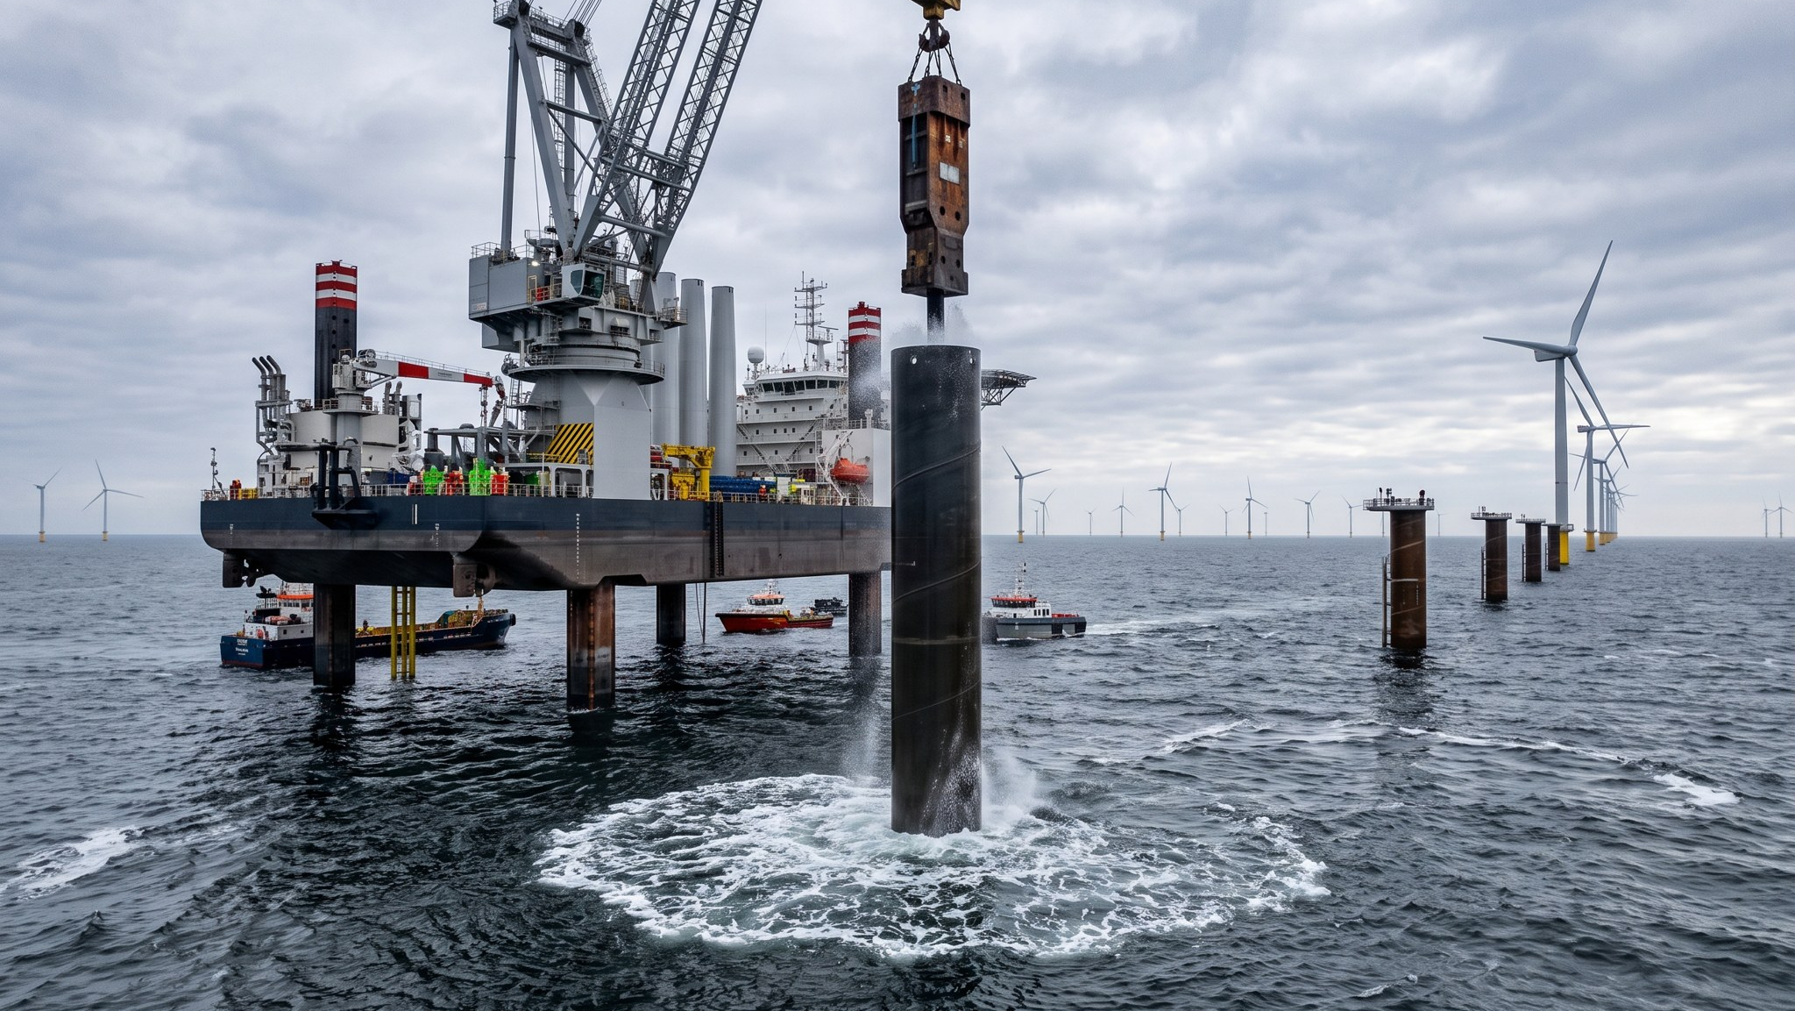
WEYLAND ENERGY
Thank you
elena.marquez@weyland-energy.example

